Slide 1

Chapter 13:
An evaluation framework

Slide 2
The aims are:
To discuss the conceptual, practical and ethical issues involved in evaluation.
To introduce and explain the DECIDE framework.

Slide 3
Evaluation paradigms and techniques
In this book we identify four core evaluation paradigms:
(1) "quick and dirty" evaluations
(2) usability testing
(3) field studies
(4) predictive evaluation.
Other texts may use slightly different terms to refer to similar paradigms.

Slide 4
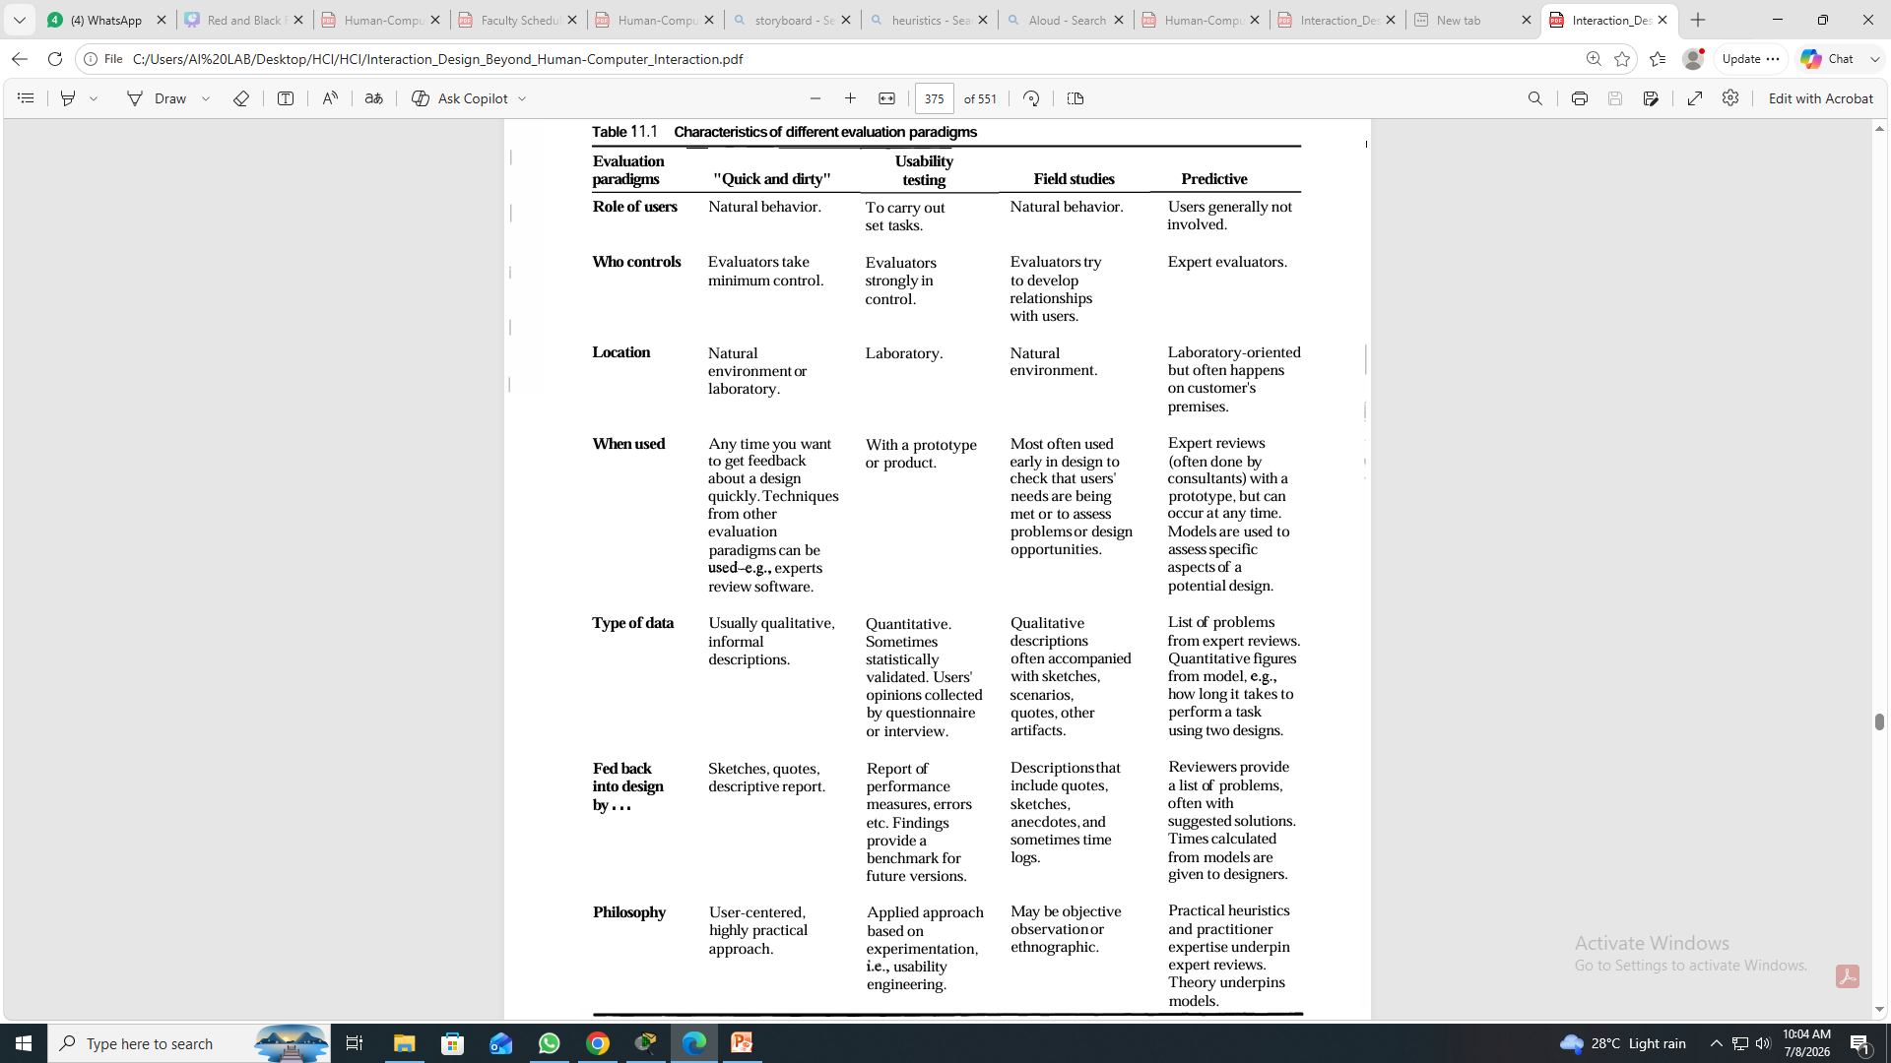
Evaluation paradigms and techniques

Slide 5
Evaluation paradigms and techniques

Slide 6
DECIDE: a framework to guide evaluation
Determine the goals.
Explore the questions.
Choose the evaluation approach and methods.
Identify the practical issues.
Decide how to deal with the ethical issues.
Evaluate, analyze, interpret and present the data.

Slide 7
Determine the goals
What are the high-level goals of the evaluation?
Who wants it and why?
The goals influence the approach used for the study
Goals should guide an evaluation, so determining what these goals are is the first step in planning an evaluation
For more clarity we can restate goal as:
  Check that the evaluators have understood the users' needs
  Identify the best metaphor on which to base the design
  Check to ensure that the final interface is consistent
  Investigate how technology affects working practices
  Improve the usability of an existing product

Slide 8
Explore the questions
All evaluations need goals & questions to guide them
Example:
the goal of finding out why many customers prefer to purchase paper airline tickets rather than e-tickets can be broken down into sub-questions:
  What are customers’ attitudes to these new tickets?
  Do customers have adequate access to computers to make bookings?
  Are they concerned about security?
  Is the interface for obtaining them poor?
  Does this electronic system have a bad reputation?
What questions might you ask about the design of a cell phone?

Slide 9
Choose the evaluation approach & methods
The evaluation approach influences the methods used, and in turn, how data is collected, analyzed and presented.
E.g. field studies typically:
  Involve observation and interviews.
  Do not involve controlled tests in a laboratory.
  Produce qualitative data.

Slide 10
Identify practical issues
  For example, how to:
    Select users
    Stay on budget
    Stay on schedule
    Find evaluators
    Select equipment

Slide 11
Decide about ethical issues
Develop an informed consent form
Participants have a right to:
- Know the goals of the study
- Know what will happen to the findings
- Privacy of personal information
- Leave when they wish
- Be treated politely

Slide 12
Evaluate, interpret & present data
The approach and methods used influence how data is evaluated, interpreted and presented.
The following need to be considered:
  - Reliability: can the study be replicated?
  - Validity: is it measuring what you expected?
  - Biases: is the process creating biases?
  - Scope: can the findings be generalized?
  - Ecological validity: is the environment influencing the findings? - i.e. Hawthorn effect.

Slide 13
Pilot studies
A small trial run of the main study.
The aim is to make sure your plan is viable.
Pilot studies check:
- that you can conduct the procedure
- that interview scripts, questionnaires, experiments, etc. work appropriately
It’s worth doing several to iron out problems before doing the main study.
Ask colleagues if you can’t spare real users.

Slide 14
Key points
  There are many issues to consider before conducting an evaluation study.
  These include the goals of the study, the approaches and methods to use, practical issues, ethical issues, and how the data will be collected, analyzed and presented.
  The DECIDE framework provides a useful checklist for planning an evaluation study.

Slide 15
A project for you …
Find an evaluation study from the list of URLs on this site or one of your own choice.
Use the DECIDE framework to analyze it.
Which paradigms are involved?
Does the study report address each aspect of DECIDE?
Is triangulation used? If so, how?
On a scale of 1-5, where 1 = poor and 5 = excellent, how would you rate this study?

